Slide 1
BOY SCOUTS OF AMERICA Order of the Arrow Croatan Lodge 117
Tentaroo Event Registration

Slide 2
Tentaroo Registration
Tentaroo is now the preferred method for registering for all Lodge events. You can register for each event individually or you can register for all events (minus the banquet) by utilizing the Express Registration option.

Slide 3
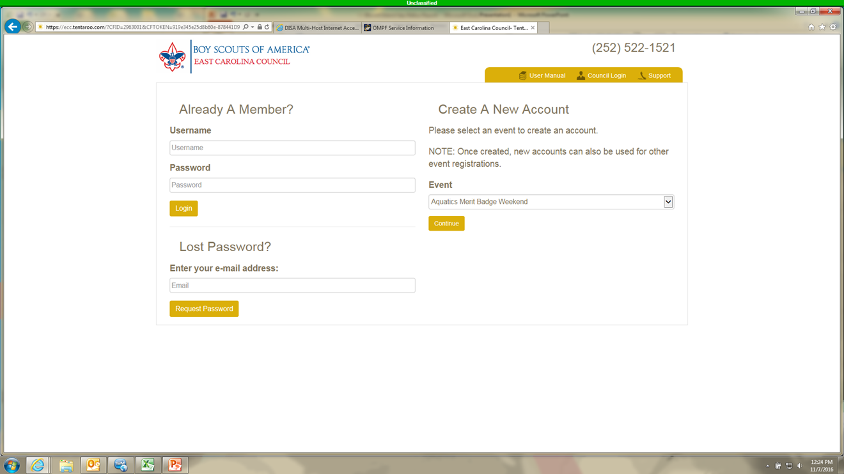
Log in if you already have an account (1) or go to the right side of the screen to create an account (2).
1
2

Slide 4
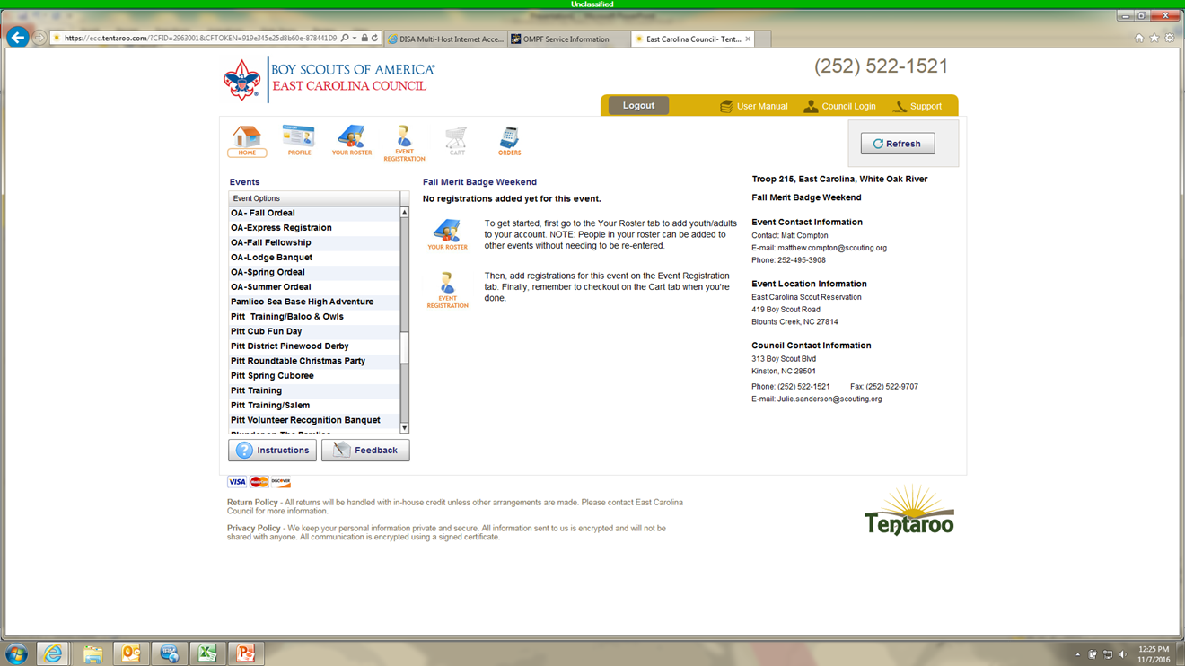
Once you log in.. arrow down (1) until you locate the OA event that you want (2).
2
1

Slide 5
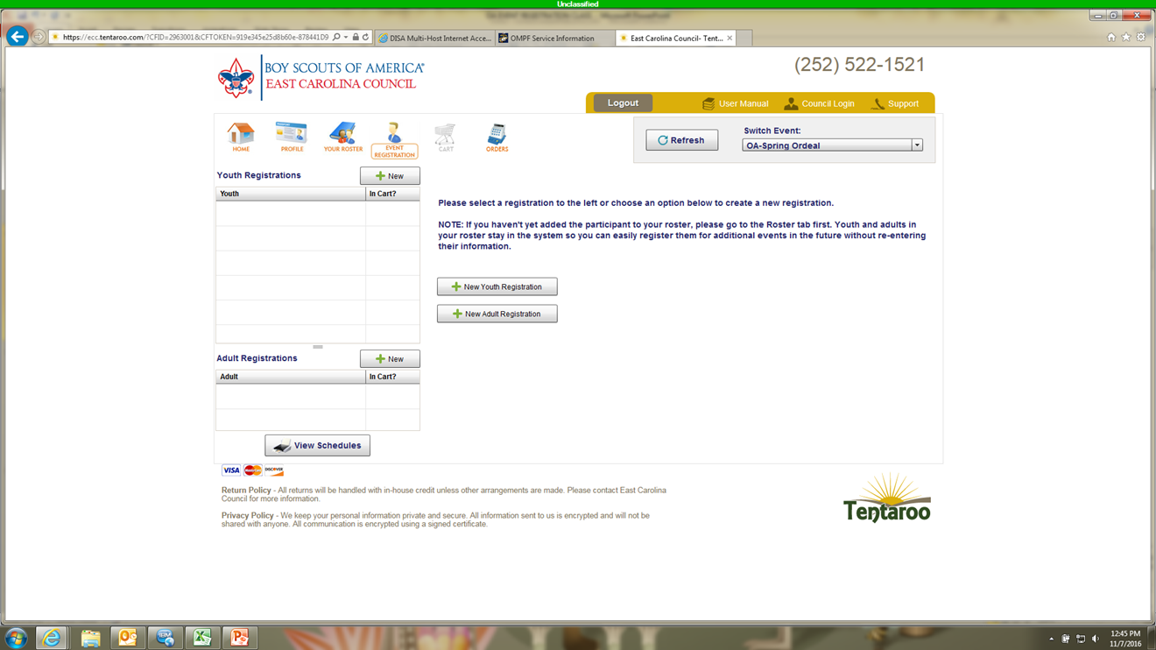
Select Your Roster if you need to add a youth/adult (1)…if not… proceed to event registration (2)(skip this slide and the next one).
1
2

Slide 6
Fill in all info (1) then click on save (2)... after you have made all necessary additions continue to event registration (3).
3
1
2

Slide 7
Select the event in the box (1) then click on event registration (2).
2
1

Slide 8
Select either New Youth Registration or New Adult Registration.

Slide 9
Select the participant name (1) then click on the drop down menu to choose participant type (2)
2
1
Note: Make sure if you are going through the Ordeal for the first time that you select Ordeal Candidate. Only current members should select one of the other 2 options.

Slide 10
Select the create registration button.

Slide 11
Ensure that all blocks contain the required information (1) … then click save (2).
1
2

Slide 12
If finished… click checkout to pay/complete registration (1) or New Youth/Adult to continue registering others for the event (2).
2
1

Slide 13
Enter all required information for your credit card (1) … then click submit my order (2).
1
2

Slide 14
Important information for Ordeal Candidates
All Ordeal Candidates need to bring the following information when they check-in for their ordeal:
Copy of their Tentaroo receipt
Completed BSA Medical Form
Copy of current Youth Protection Training certificate (Adults only)

Slide 15
Questions
If you have any questions in regards to getting registered you can contact:
Rick Nezbeth
(910) 548-0220
rnezbeth@hotmail.com

